Slide 1


Company profile
The information contained in this document is the property of Eurokleis s.r.l. This information is closely linked to the oral comments that have accompanied the presentation and can be used only by the people who attended the meeting. Copying, publishing or distributing the material contained in this document is prohibited and may be illegal.

Slide 2

About us
Our offices
Eurokleis was founded in 2000 as an academic spin-off that brings together economic, technological, business and legal competencies
offers advisory in all business fields with special attention to innovative enterprises
provides its knowledge in applied research and integrates different and flexible expertise
provides its products/services in 4 business areas Start, Grow, Innovate and Comply; Legal consultancy complete the market offer
has strong expertise in Research projects with 15 years of experience and more than 15 European Research Projects
Milano
Roma
Your ideas become real business
Supporting business change and sustainability
Shape your future
Minimize risks and exploit your potential
Legal Consultancy
National and European projects

Slide 3



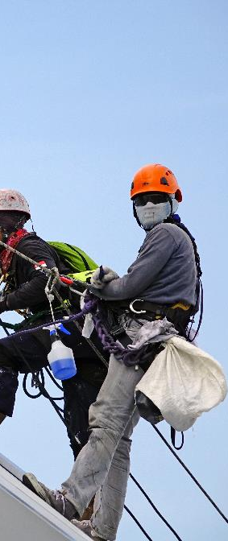
START
GROW
your ideas become real business
support business change and sustainability
START-UP
MODELS
FEASIBILITY
FINANCE
STRATEGY
SUSTAINABILITY
Starting from your
business idea
Establishment
Incubation
Start-up VISA
Innovative start-ups
Business networks
Effective business models for your company
Customer segments
Value proposition
Channels & Customer relationships
Costs & Revenues
Key activities, resources & partnerships
Reducing business risk and identifying target markets
Market research
Logistic and distribution models
Geomarketing
Growth through sustainable corporate finance
Corporate valuation
Mergers & Acquisitions
Initial Public Offering (IPO)
Valuation of financial assets
Subsidized financing
Strategize your growth
The future of the world
ESG e SDG
DNF DL 254/2016
Benefit corporation
Impact measurement
Life Cycle Assessment
Business Strategy
Industrial plans
Distribution network optimization
Change management
Value (co)creation
Digital transformation
Innovation Strategy
Decision Support Systems
Data architecture & management
Business Intelligence
CRM
Technological audit
INNOVATE
COMPLY
shape your future!
minimize risks and exploit your potential
MANAGEMENT
TRANSFER
EVALUATION
TAX
ACCOUNTING
RISK & AML
Innovation management requires specific skills
Project management
Exploitation of innovation
Dissemination of results
Maximizing the value of intangibles
Intellectual Property Rights
Partnerships
Spin-offs
Best value for money is always the objective
Assessment of investment projects/programs
Valuation of intangibles
Monitoring
Financial audit
Not a burden anymore
Advisory
Planning
Litigation
Extraordinary operations (voluntary disclosure, patent box etc.)
Qualitative and quantitative information for the annual report
Impairment test (IAS 36)
Employee and agents benefits (IAS 19/IAS 37)
Intangibles (IAS 38/IFRS5)
Financial Instruments (IAS 39)
Compliance as an opportunity for continuous improvement
Organizational Models D.Lgs 231/01
Anti Money Laundering/Anti-terrorism
Operational Risk
Fraud detection
Privacy and GDPR

Slide 4

RESEARCH
Bring the future closer
we are your partner
for successful EU projects
Our roles in the projects
    Innovation management (technology transfer, business model, project management, IPR, start-up e spin-off etc.)
    Dissemination & Communication (dissemination of scientific results, events, social media management etc..)
    Exploitation of the project results
    Socio-economic and technological impact assessment
    Data Modelling (Big data, Blockchain, Business intelligence and data visualization)
    Proposal writing management and administrative support
Horizon Europe Topics of interest
  EIC Pathfinder
  EIC Transition
  EIC Accelerator
  Climate neutral, circular and digitised production
  Increased autonomy in key strategic value chains for resilient industry
  World leading data and computing technologies
  Digital and emerging technologies for competitiveness and fit for the green deal
  Open strategic autonomy in developing, deploying and using global space-based infrastructures, services, applications and data
  A human-centred and ethical development of digital and industrial technologies
  Low-carbon and competitive transport solutions
  across all modes
  Research infrastructures

Slide 5










RESEARCH
Bring the future closer
some of our latest
EU funded projects
FETPROACT-2018-2020
Enhanced regenerative medicine for the development of biohybrid neuronics that aims integration of bioengineered brain tissues, neuromorphic microelectronics and artificial intelligence for the treatment of neurological diseases
FP7-ICT-611253
The IA4SI project aims to develop a structured methodology able to assess the potential socio-political, economic and environmental impacts of social innovation initiatives
Creative Europe Programme
Futures is a photography platform that pools the resources and talent programmes of leading photography institutions across Europe in order to increase the capacity, mobility and visibility of its selected artists
CIP-ICT-PSP-2013-7
JamToday is the first European network dedicated to the design of serious games, i.e. games not aimed at simple entertainment but with specific educational purposes, through the use of game jam
H2020-ICT-2016-2-761934
Hyper360 aims to boost the media sector by providing the innovative solutions to the 360 video capturing and production making it more immersive and personalised by adding 3D mentors and annotation tools
FP7-SST-2012-RTD-1
METPEX is a research project aimed at developing a methodology and the creation of standardized tools able to measure the entire travel experience of a passenger, before, during and after the use of public transport
H2020-MG-2015_TwoStages-690650
SUITS project aims to support the Local Authorities of small and medium cities in enhancing their capacity of building the sustainable urban mobility systems by providing the Guidelines, workshops etc.
FESR 2007-2013
In the field of IT identification, the ProCIDA project is part of a strong personal authentication model and a whole series of value-added services
H2020-ICT-2015-688541
I3 is a coordination and support action project that helped the ICT-19 projects and media innovators to reach the market by providing the coaching session for instance regarding the business modelling and investment opportunities, impact assessment tools and developing the policy dialog for the policy makers
    FESR 2007-2013
The NEMESYS project aims to develop an innovative platform, based on a cloud computing infrastructure, to support companies in the phases of collaboration and conduction of business

Slide 6
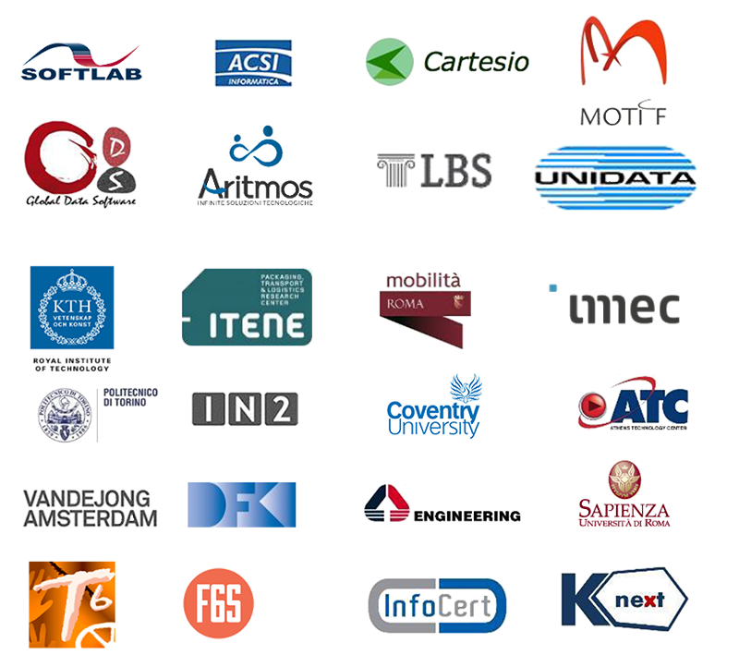
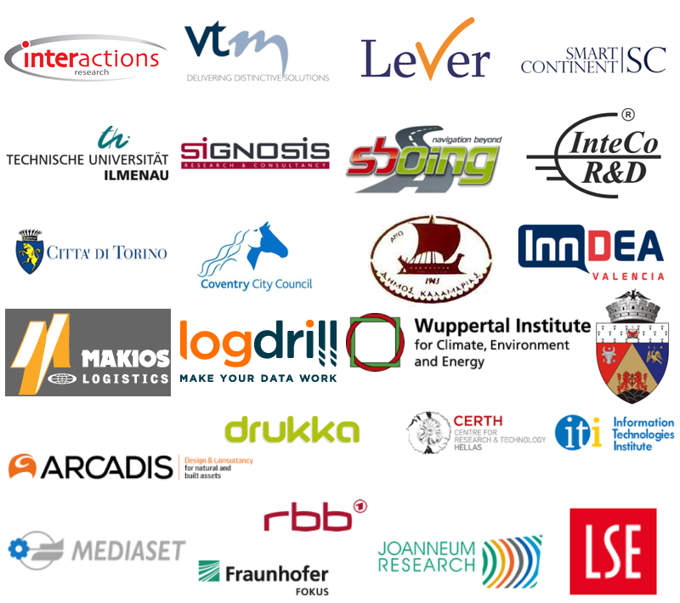











RESEARCH
Bring the future closer
our partner
network

Slide 7
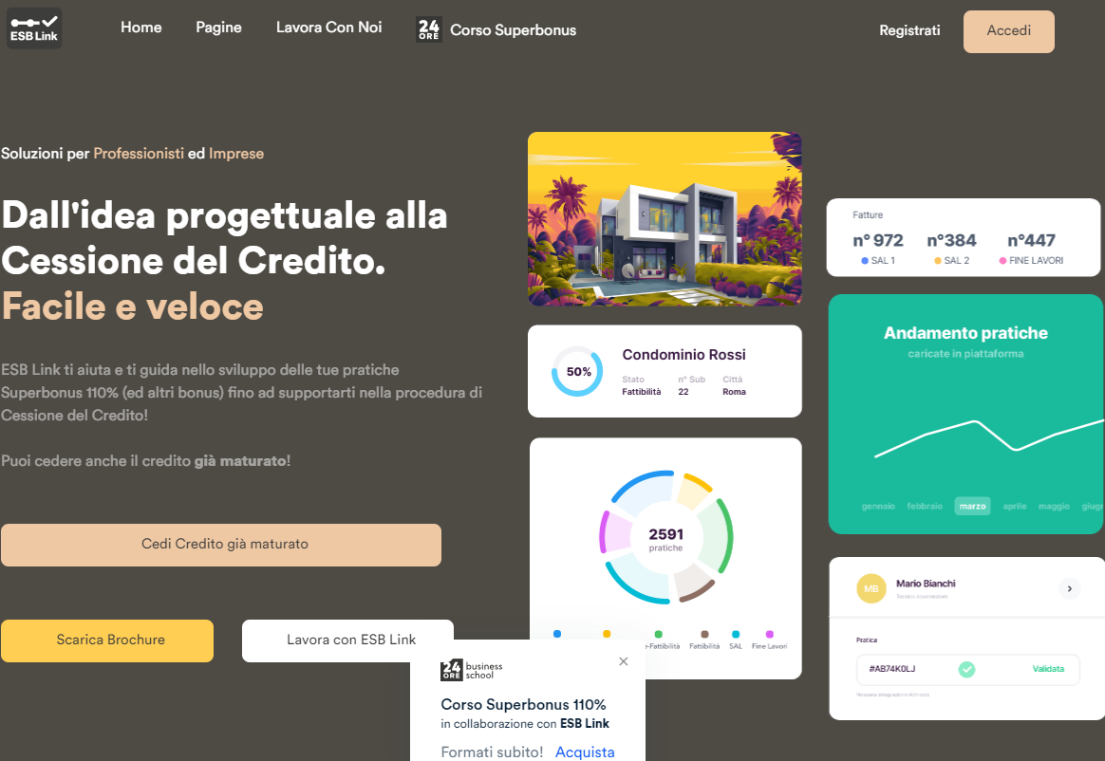




START
Bring the future closer
our startups
POOL IMPRESE-PROFESSIONISTI
CONDOMINIO/PROPRIETÀ
PRODOTTI ASSICURATIVI
ASSISTENZA
TECNICA
LIQUIDITÀ
FORMAZIONE
CESSIONE DEL
CREDITO
SEGNALAZIONE
SEGNALAZIONE
BANCHE
INTERMEDIARI FINANZIARI
ASSICURAZIONI
ASSICURAZIONI
Piattaforma gestione e
compliance
AGENZIA DELLE ENTRATE

Slide 8

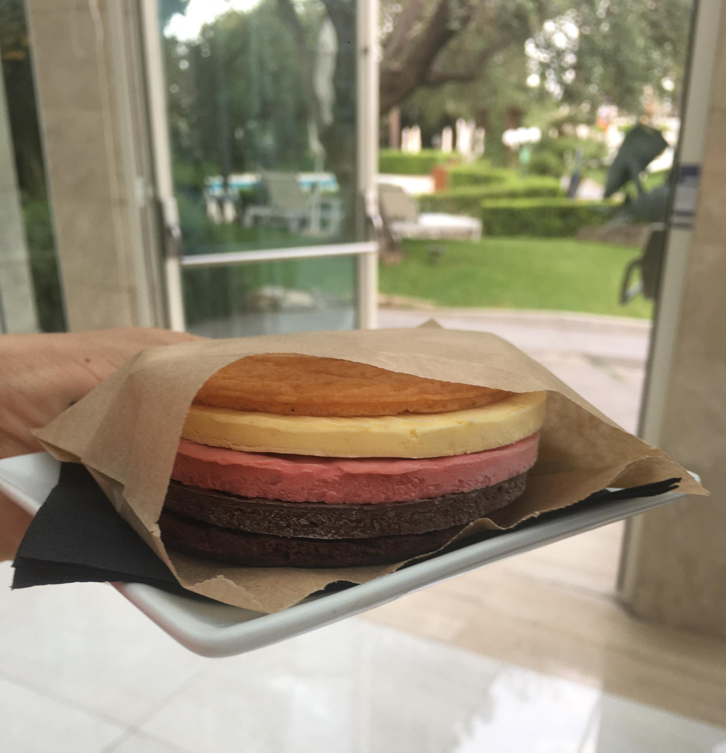
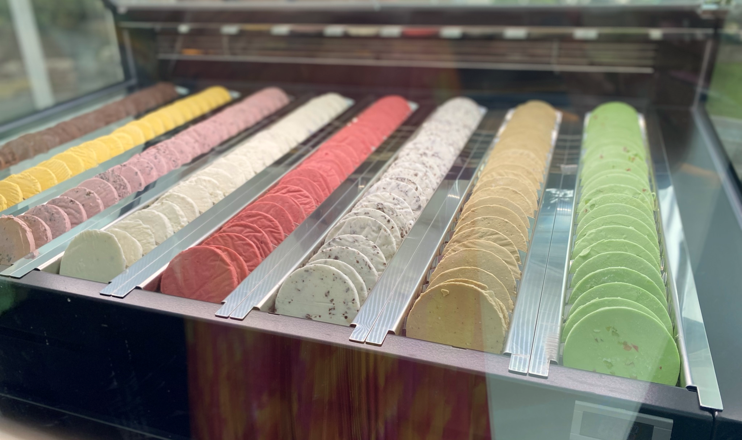
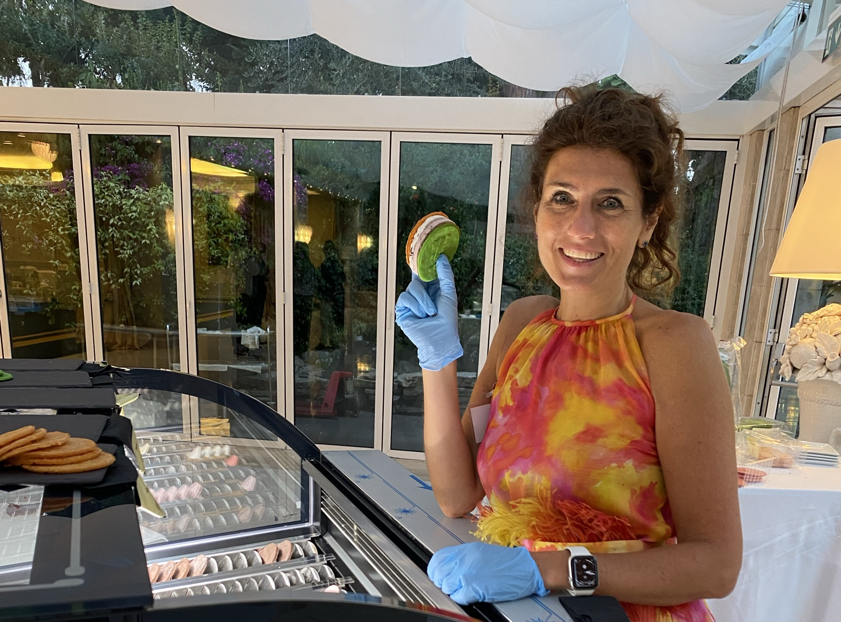
START
Bring the future closer
our startups

Slide 9
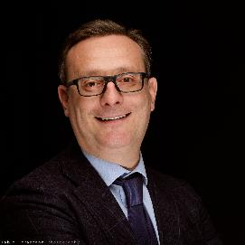


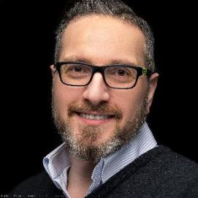
Let’s shape the future together
FOLLOW OUR EU PROJECTS NEWS www.eurokleis.com/european-projects
Francesco Bellini
senior partner & founder - Innovation & Finance
Giorgia Fiume
senior partner & CEO - Technology
Valentina Ghegin
consultant - Innovation & Finance
Luca Satolli
senior partner & founder - Technology

Slide 10
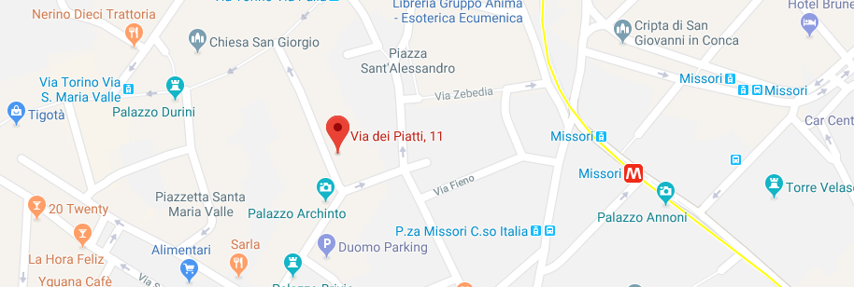
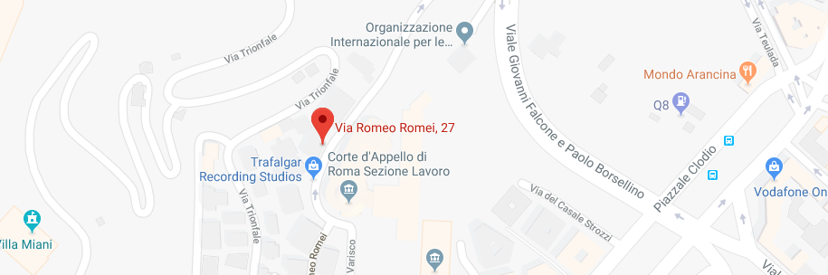
CONTACT US
ITALY
Rome
ITALY
Milano – Via dei Piatti, 11 20123
Roma – Via Romeo Romei, 27 - 00136
USA OFFICE
South America
02 40 03 12 89 - 06 44 25 40 74
info@eurokleis.com
1243 Barker Cypress
San Francisco, California

Slide 11




FOLLOW US
Rome
www.eurokleis.com

